Slide 1
Online Safety
Parent workshop

Slide 2
Agenda
What is online safety and why is it important?
What do we know about the apps our children use?
How to stay safe online – what can we do?
How can we educate our children and support them to make safe decisions?

Slide 3
What is online safety?

Slide 4
What are the different apps children use?
Bing Videos

Slide 5
Parent App quiz
Can you name the apps and add on the age restrictions?

Slide 6
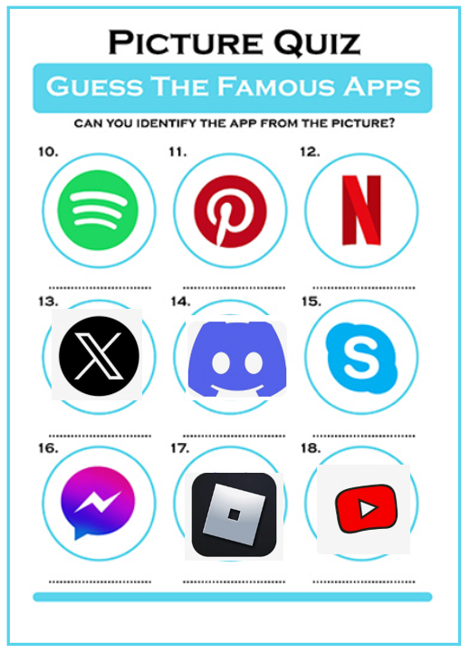
Parent App quiz
Can you name the apps and add on the age restrictions?

Slide 7
Popular Games and age restrictions
7 years
3 years
14 years
12 years
16 years
9 years
18 years

Slide 8
Online Safety Video
Free online safety virtual workshop | NSPCC
NSPCC

Slide 9
What can we do to keep children safe?

Slide 10
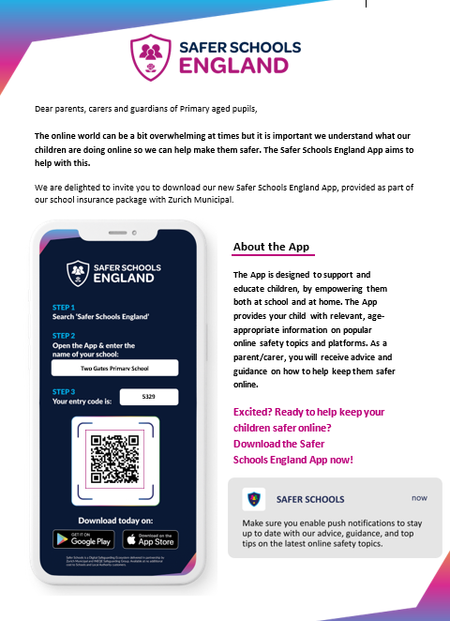
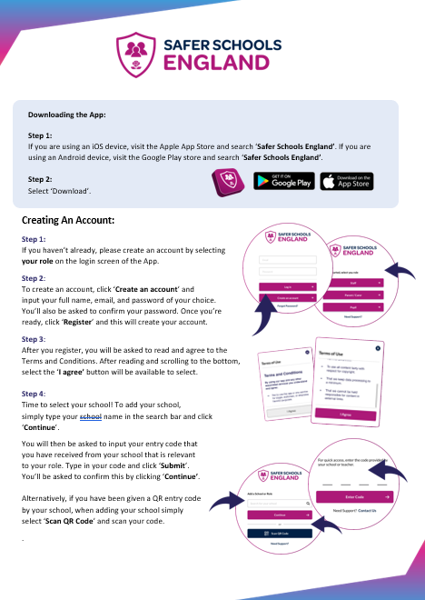
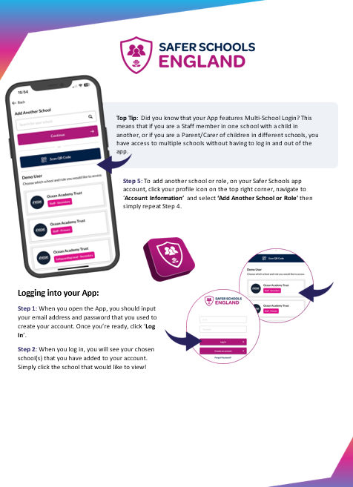
Safer Schools App
Guide

Slide 11
Safer Schools - Stories and questions for children.

Slide 12
Pupil quiz

Slide 13
Scenario cards - activity

Slide 14
Websites that can help further

Slide 15
THANK YOU
Thank you for working with us to keep children safe online.

